Slide 1
Comprehensive Guide on Data Science
Definition, Applications, Tools, and Future Scope

Slide 2
What is Data Science?
Data Science is an interdisciplinary field that uses scientific methods, algorithms, and systems to extract insights from structured and unstructured data.

Slide 3
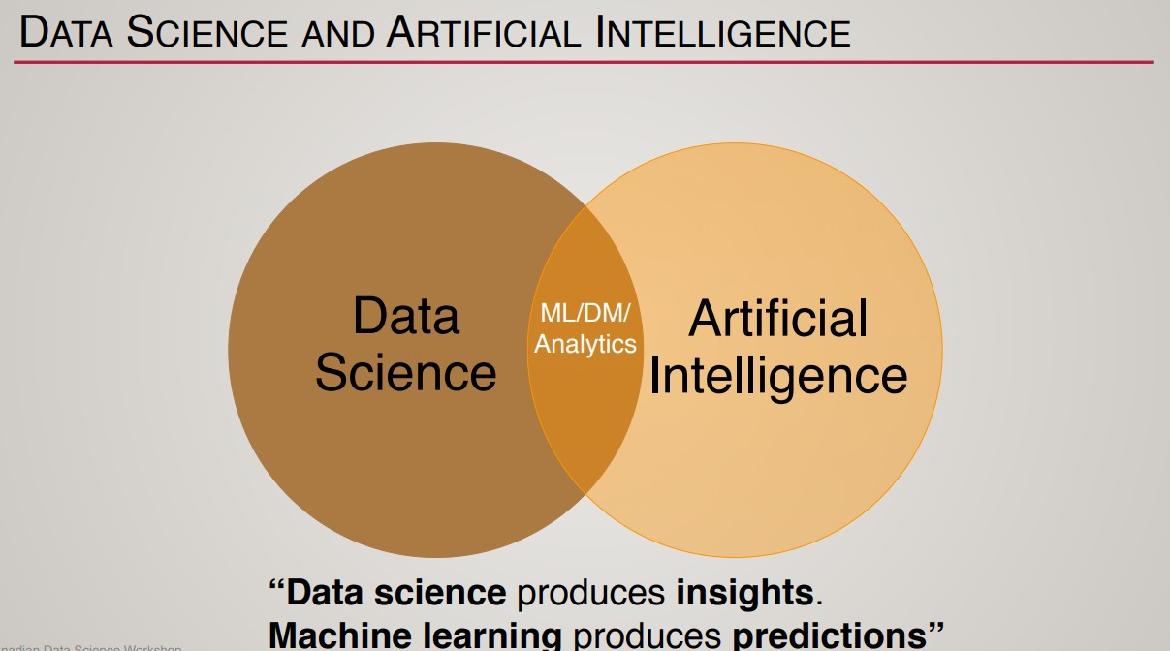

Slide 4
Steps in DS
Collect large amounts of data
Analyze the data
Interpret the data: answer questions like what, when, where, why, how happened
Use the results to plan and make decisions
“It is a capital mistake to theorize before one has data.” — Sherlock Holmes

Slide 5
Core Components of Data Science
Data Collection: Gathering data from various sources such as databases, APIs, sensors, and web scraping.
Data Cleaning and Preprocessing: Handling missing values, noise, and inconsistencies to prepare clean data for analysis.
Exploratory Data Analysis (EDA): Visualizing and summarizing data to discover patterns, trends, and relationships.
Feature Engineering: Creating new features or selecting important ones to improve analysis or model performance.
Statistical Analysis: Applying statistical techniques to test hypotheses and infer conclusions from data.
Data Modeling (Optional ML Integration): Using models for prediction, classification, or clustering when required.
Interpretation and Reporting: Translating results into actionable insights through reports, dashboards, or presentations.
Deployment and Decision-Making: Implementing findings in real-world processes or systems to guide decisions.

Slide 6
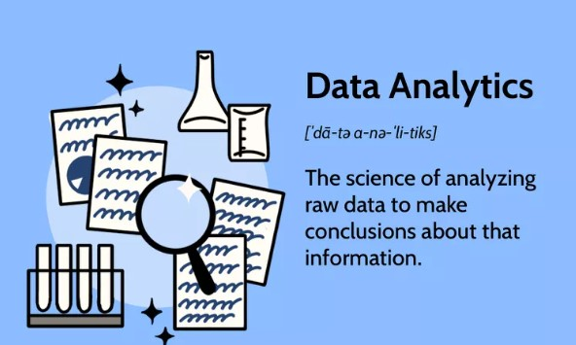
Analyze the data
Descriptive analysis: Summarizes data to understand its basic characteristics
Exploratory data analysis (EDA): Uses visual methods like scatter plots, histograms, and box plots to explore data, spot anomalies, and test hypotheses
Regression analysis: A statistical method that examines the relationship between one or more independent variables and a dependent variable
Factor analysis: A type of regression analysis that groups variables into factors to identify underlying relationships
Cluster analysis: Groups similar data objects into clusters
Cohort analysis: Analyzes data over time for a specific group of related customers
Monte Carlo simulation: A computer-run predictive analysis that models the probability of different outcomes
Time series analysis: Tracks data over time to solidify the relationship between the value of a data point and its occurrence
Sentiment analysis: Assesses the emotional tone of textual data, such as customer reviews or social media posts

Slide 7
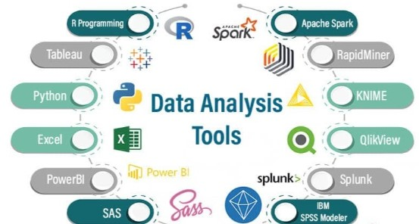

Slide 8
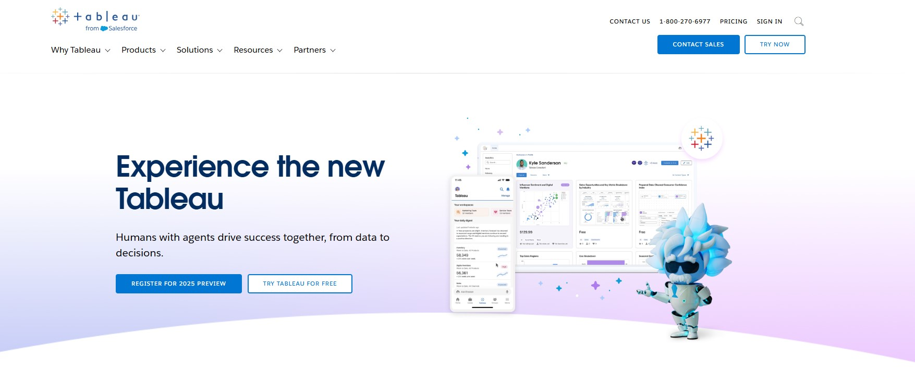

Slide 9
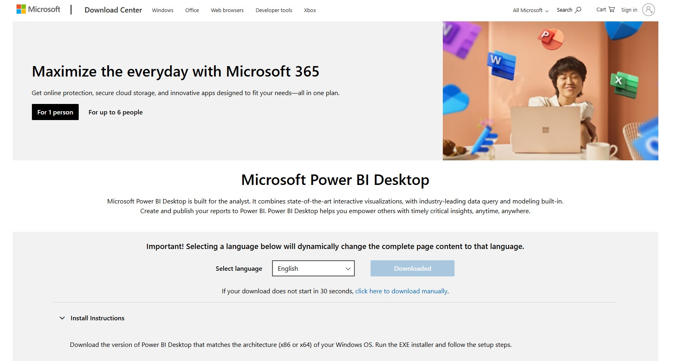

Slide 10
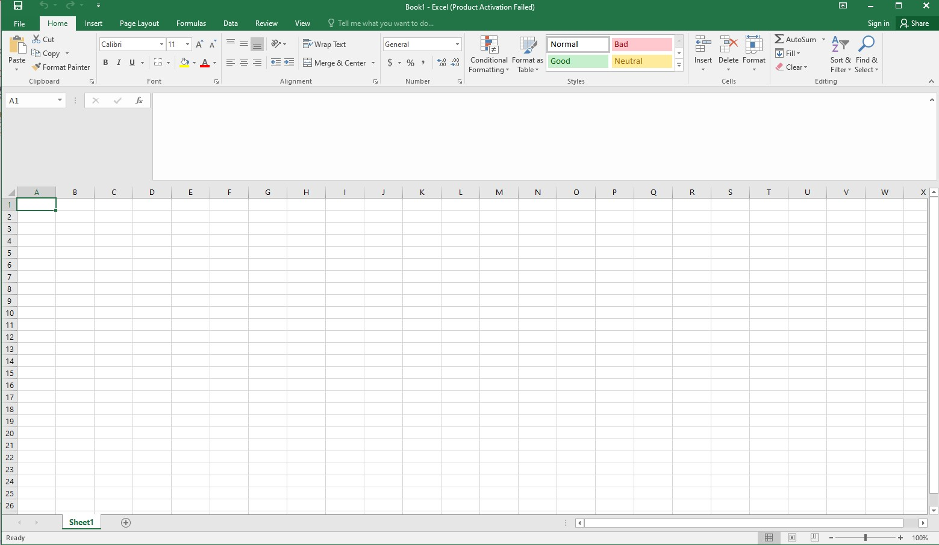

Slide 11
Applications of Data Science - Part 1
1. Business and Marketing: Customer segmentation, campaign analysis, market trend forecasting
2. Healthcare: Patient data analysis, disease tracking, research insights

Slide 12
Applications of Data Science - Part 2
3. Finance: Risk management, loan default prediction, portfolio analysis
4. Government: Census analysis, resource allocation, crime trend detection

Slide 13
Applications of Data Science - Part 3
5. Manufacturing: Quality control, supply chain optimization
6. Education: Performance analysis, curriculum effectiveness, dropout prediction

Slide 14
Future Scope of Data Science
1. Growing Industry Demand
2. Integration with AI/ML
3. Real-Time Data Processing
4. Personalized Experiences
5. Ethical and Responsible Data Use
6. Data-Driven Culture

Slide 15
Popular Tools & Technologies
Programming: Python, R, SQL
Data Handling: pandas, NumPy
Visualization: Matplotlib, Seaborn, Power BI, Tableau
Statistical Analysis: SciPy, statsmodels
Databases: MySQL, PostgreSQL, MongoDB
Big Data: Apache Spark, Hadoop
Notebooks: Jupyter, Colab

Slide 16
Learning Path for Beginners
1. Learn Programming (Python or R)
2. Study Basic and Advanced Statistics
3. Practice Data Wrangling and Visualization
4. Work on Real Datasets
5. Build Dashboards
6. Learn Cloud/Big Data Basics
7. Create a Portfolio

